Slide 1
Comparing Sentences By Semantic Similarity
Jonathan Pruchansky

Slide 2

The Task
How can we detect when sentences have the same semantic meaning?

Slide 3

Dataset
Provided by Quora
Over 400,000 training examples.

Slide 4


Examples
different semantic meaning
same semantic meaning

Slide 5
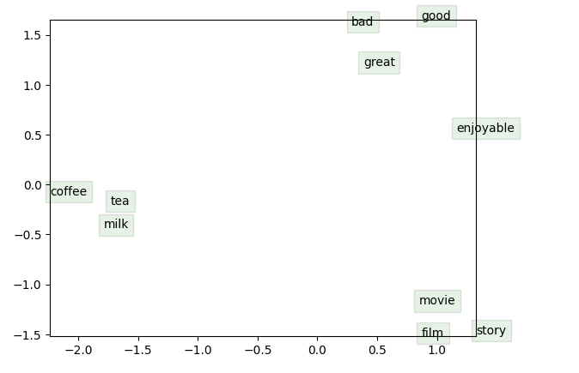
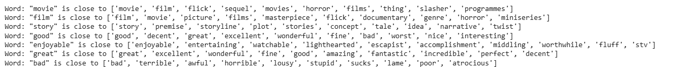
Pretrained Embeddings

Slide 6
Approach
Model 1:
Fully Connected Feedforward Network
Model 2:
Recurrent Neural Network + Cosine Similarity
Model 3:
Encoder + Decoder Model

Slide 7
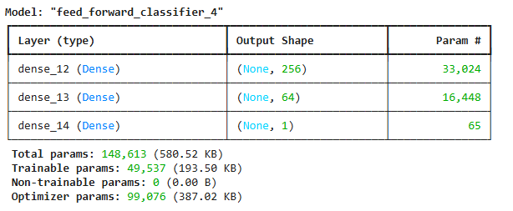
Model 1
Model 1:
Fully Connected Feedforward Network

Slide 8
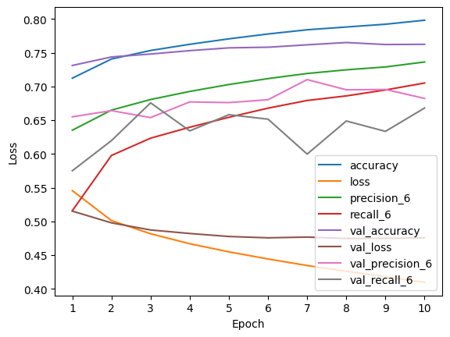
Training Stats

Slide 9
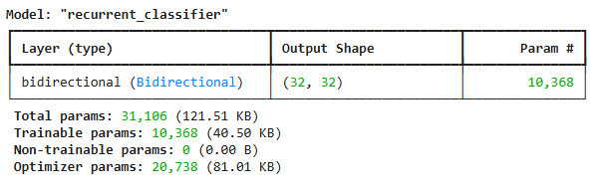
Model 2
Model 2:
Recurrent Neural Network + Cosine Similarity

Slide 10
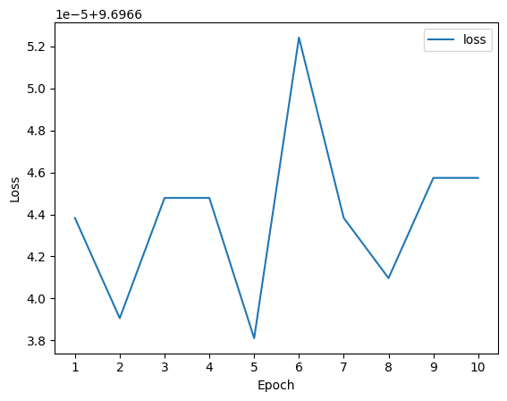
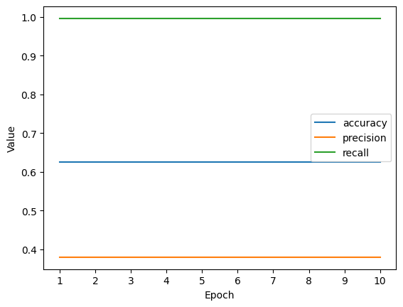
Training Stats

Slide 11
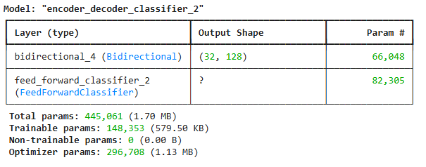
Model 3
Model 3:
Encoder + Decoder Model

Slide 12
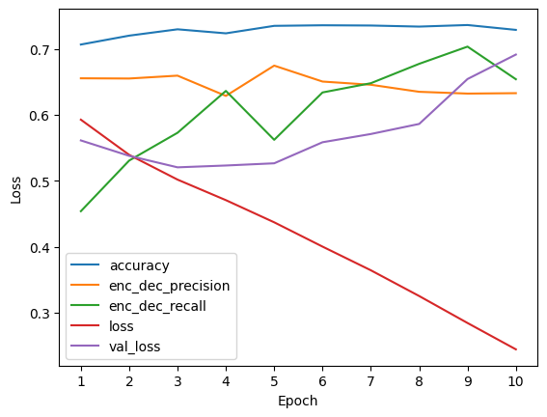
Training Stats

Slide 13
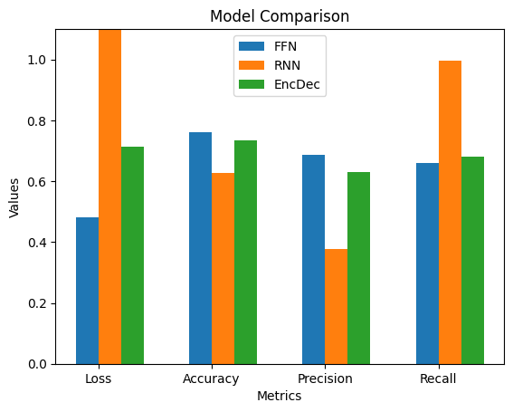
Results

